Slide 1

Rethinking Follow Up Care While Addressing
Bladder Cancer Survivors Needs
Deborah K. Mayer, PhD, RN, AOCN, FAAN
Frances Hill Fox Distinguished Professor, School of Nursing
Director, Cancer Survivorship
UNC Lineberger Comprehensive Cancer Center
University of North Carolina
Chapel Hill, NC 27510
Interim Director of the Office of Cancer Survivorship
Division of Cancer Control and Population Sciences
National Cancer Institute

Slide 2
Disclosures
I am a stockholder and advisor to Carevive Systems
I will not discuss any drugs during this presentation

Slide 3
Objectives
Examine cancer statistics
Define cancer survivor and survivorship care
Appraise survivorship issues bladder cancer survivors face
Reframe follow-up care for bladder cancer survivors
Describe needed survivorship research

Slide 4




Survivorship Over Time
“War”
“Competition”
“Journey”
1950 5-yr
survival = 30%
1975 5-yr survival = 48%
2019 5-yr survival = 68%
1986
1996
2005
2007
3m
16.9 m
“Good Patient”
“Empowered Patient”
“Victims”
“Survivors”

Slide 5


Cancer in the US
More Than a Statistic

Slide 6
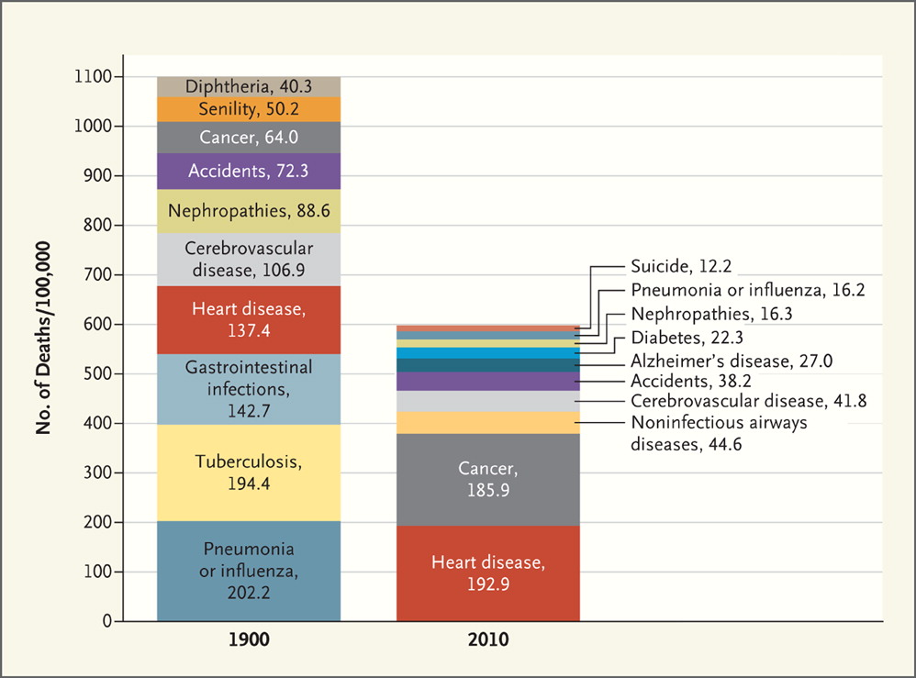
Jones DS et al. N Engl J Med 2012;366:2333-2338.
Top 10 Causes of Death: 1900 vs. 2010
Notes:
Top 10 Causes of Death: 1900 vs. 2010. Data are from the Centers for Disease Control and Prevention.

Slide 7
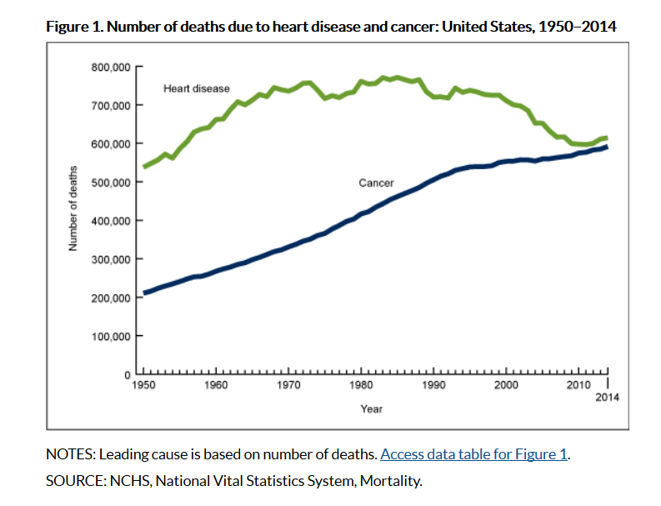
Notes:
Data from the National Vital Statistics System
Heart disease has consistently been the leading cause of death in the United States and remained so in 2014.
The gap between the number of heart disease and cancer deaths generally widened from 1950 through 1968, narrowed from 1968 through 2012, and then slightly widened again from 2012 through 2014.
The mortality burden of cancer has surpassed that of heart disease in several states. In 2000, there were only 2 states where cancer was the leading cause of death; in 2014, there were 22.
Heart disease remained the leading cause of death for the non-Hispanic white and non-Hispanic black populations in 2014.
Cancer is now the leading cause of death for the non-Hispanic Asian or Pacific Islander and Hispanic populations. The timing of the leading-cause crossover varied by group.
For the total U.S. population, heart disease has been the leading cause of death for decades, with cancer the second leading cause (1). However, the ranking of these causes has varied across demographic group and geographic unit over time. Rankings are based on the number of deaths and reflect mortality burden rather than risk of death (2). This report highlights changes in the mortality burden of heart disease and cancer and presents findings by state, race, and Hispanic origin.

Slide 8
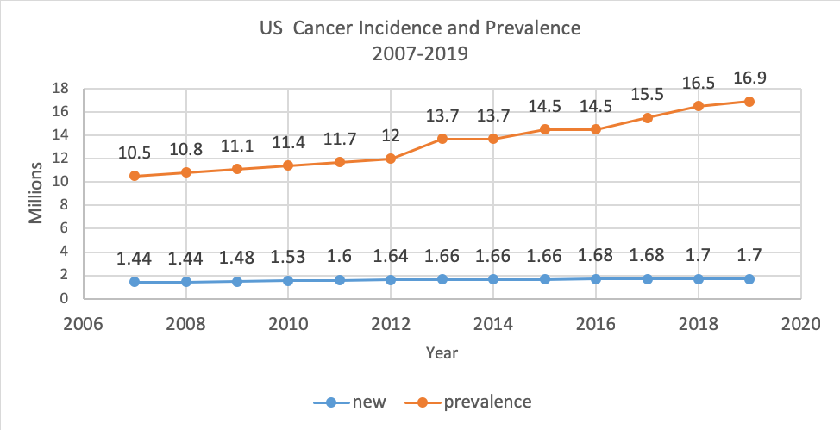
SEER Data

Slide 9
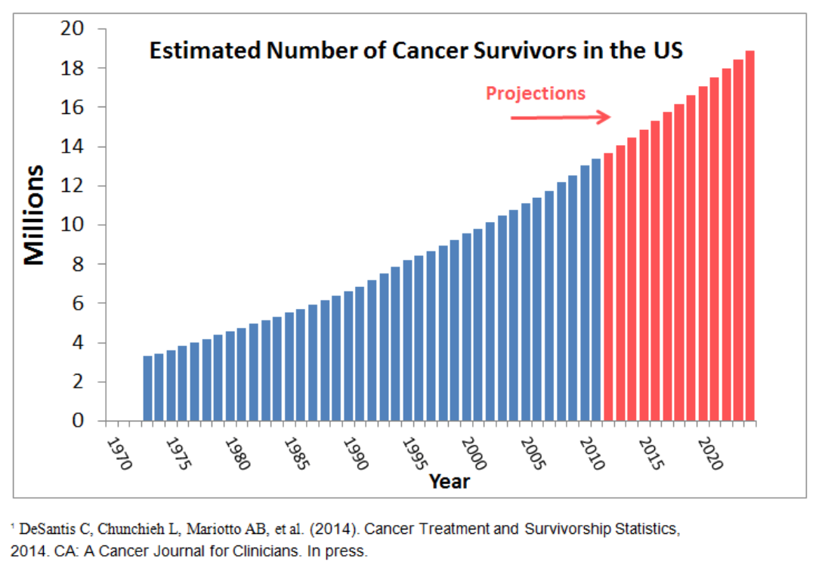
The number of cancer survivors is projected to increase by 31%,
to almost 26 million, by 2040

Slide 10
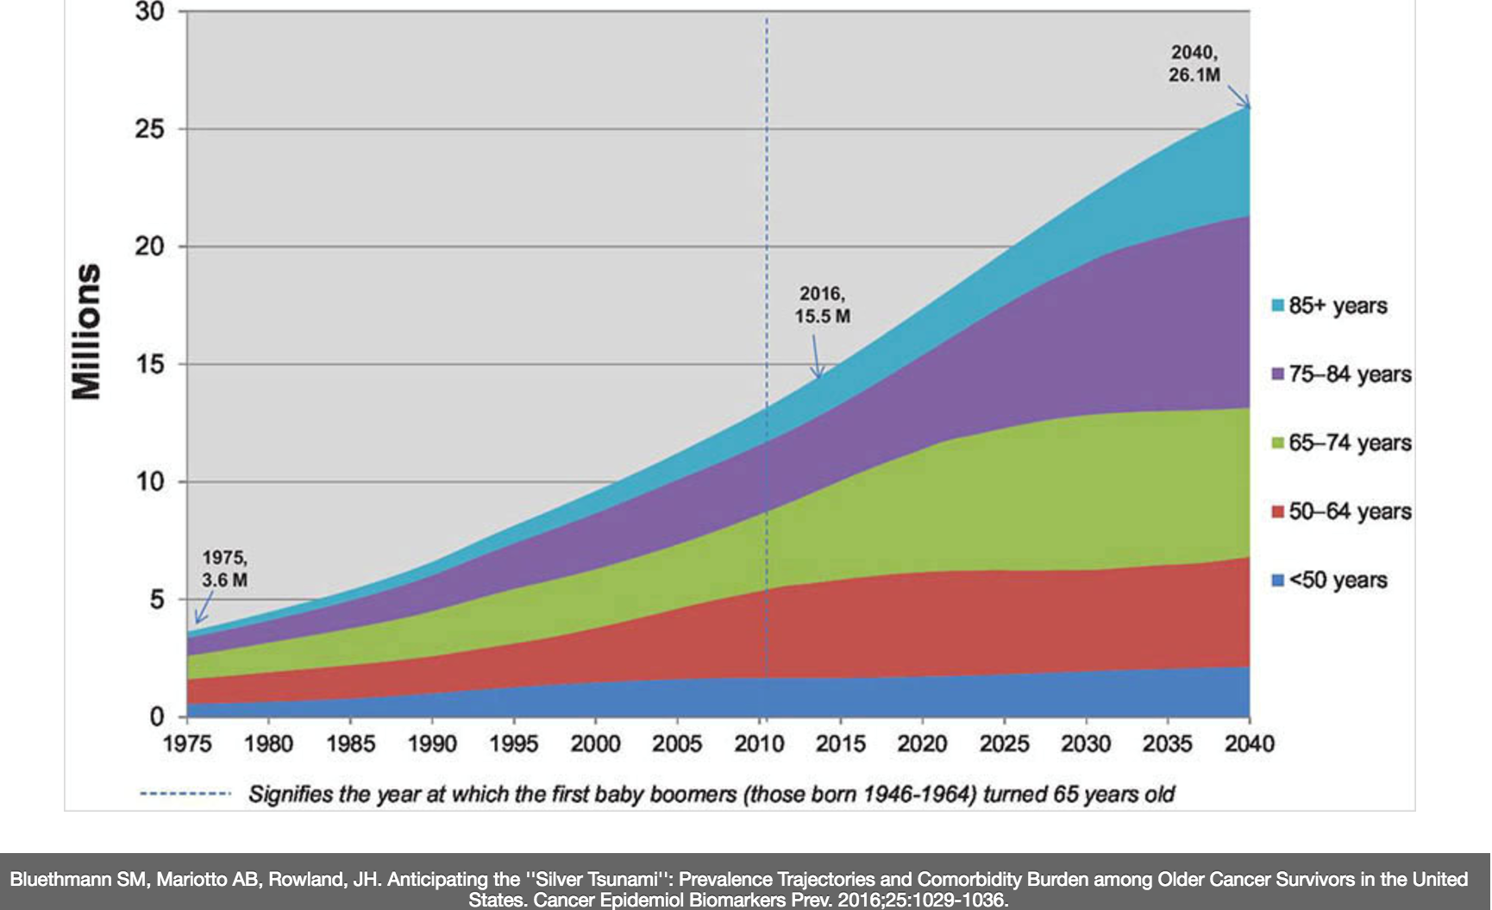
Survivors Projected in US (1975- 2040)
By 2040, 73% will be > 65
2019,
16.9
Notes:
It is estimated that by 2040, 73% of cancer survivors in the United States will be 65 years or older.

Slide 11
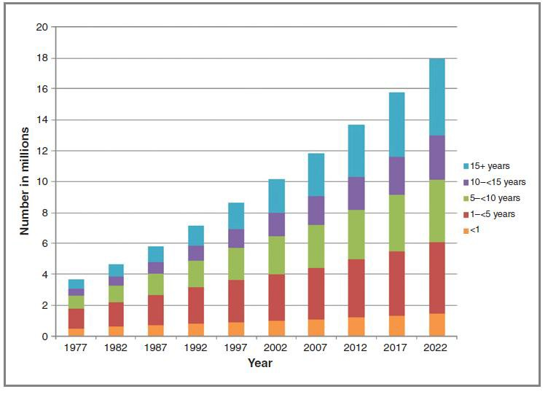
Survivors Projected in 2022
Over next 10 years, those living beyond 5 years will increase by 35%

Slide 12
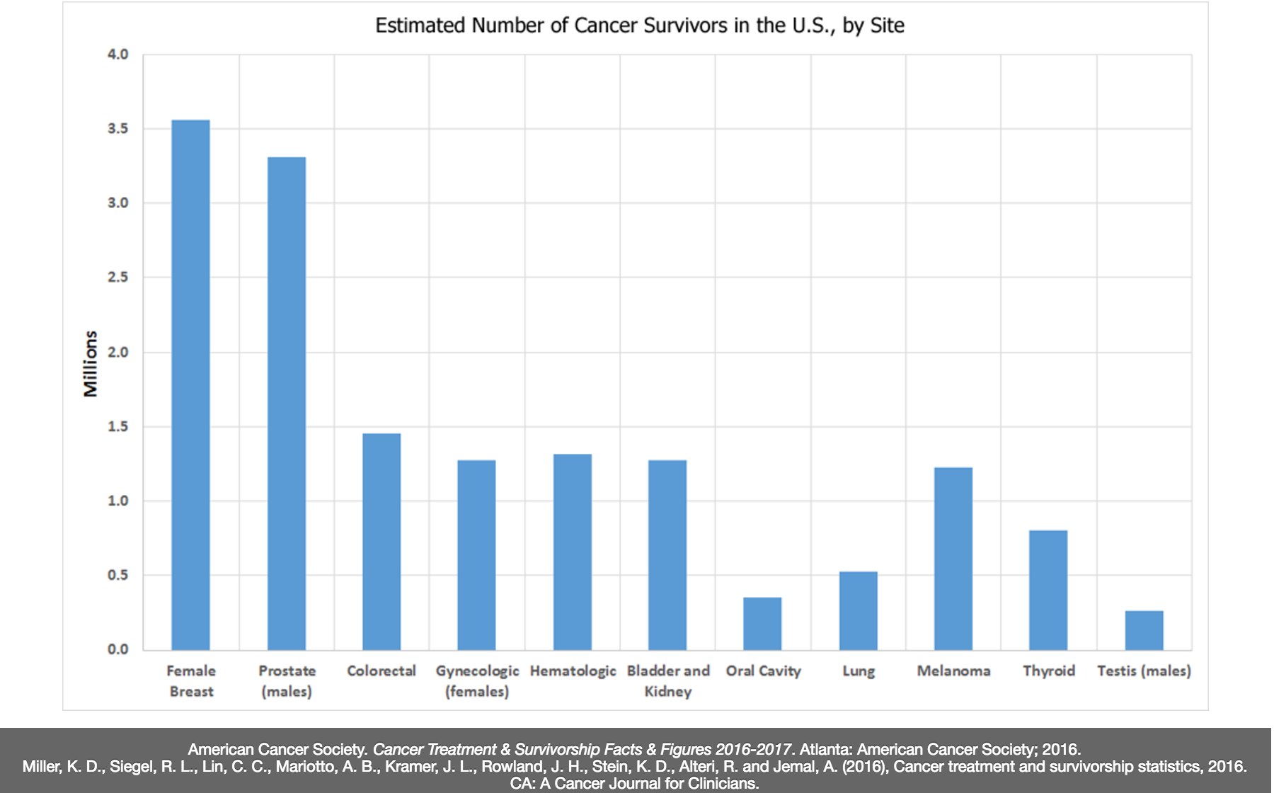
High Volume
High Need

Slide 13
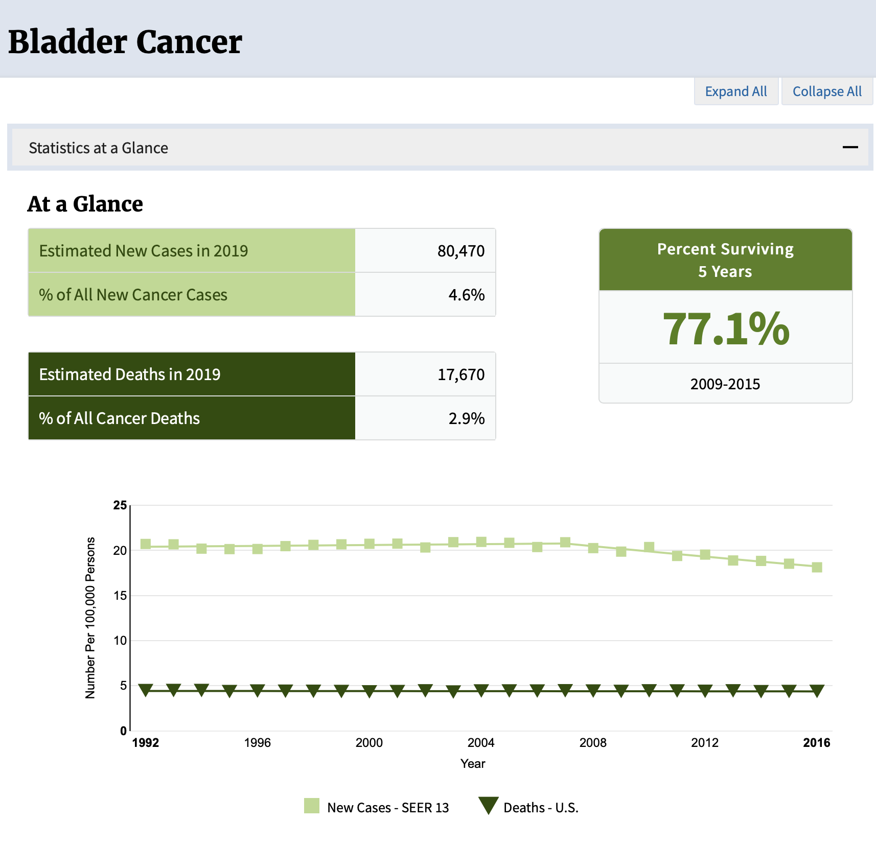
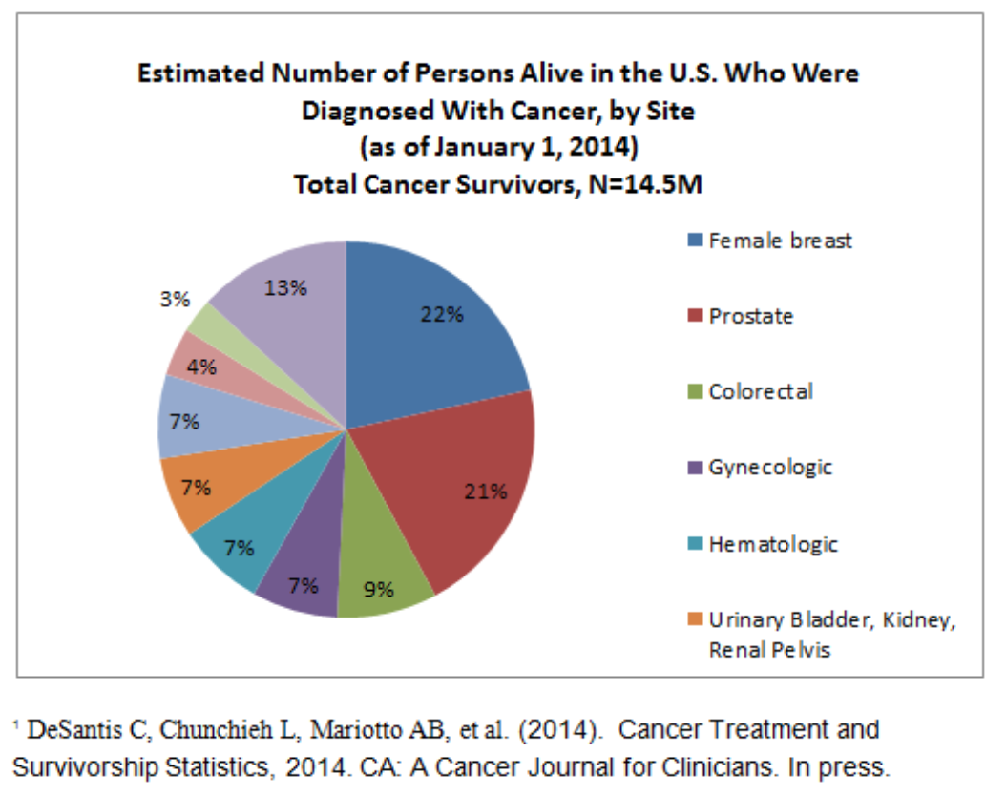

Slide 14
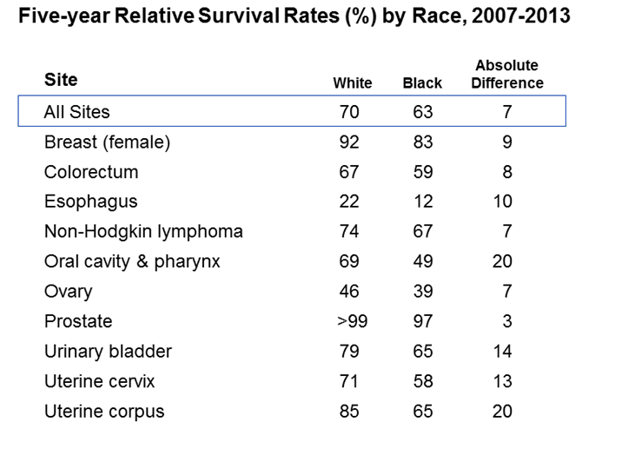
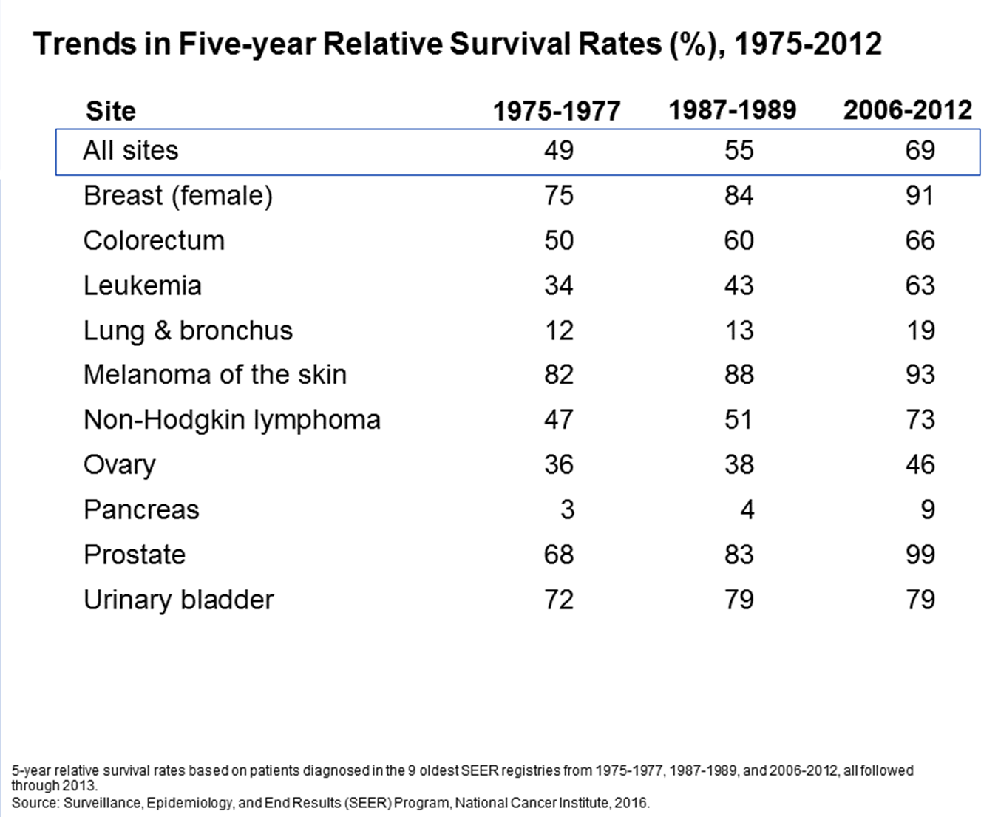
In 2016, there were an estimated 699,450 people living with bladder cancer in the United States.
Notes:
While gains in survival have occurred for both whites and blacks, blacks have lower survival rates than whites for most cancer types. The largest differences are for cancers of the oral cavity and uterine corpus. Factors that contribute to racial disparities in survival include a later stage of diagnosis among blacks, as well as a lower likelihood of receiving high quality treatment. Additional factors include differences in tumor characteristics unrelated to early detection and differences in the prevalence of comorbidities (other health conditions).

Slide 15
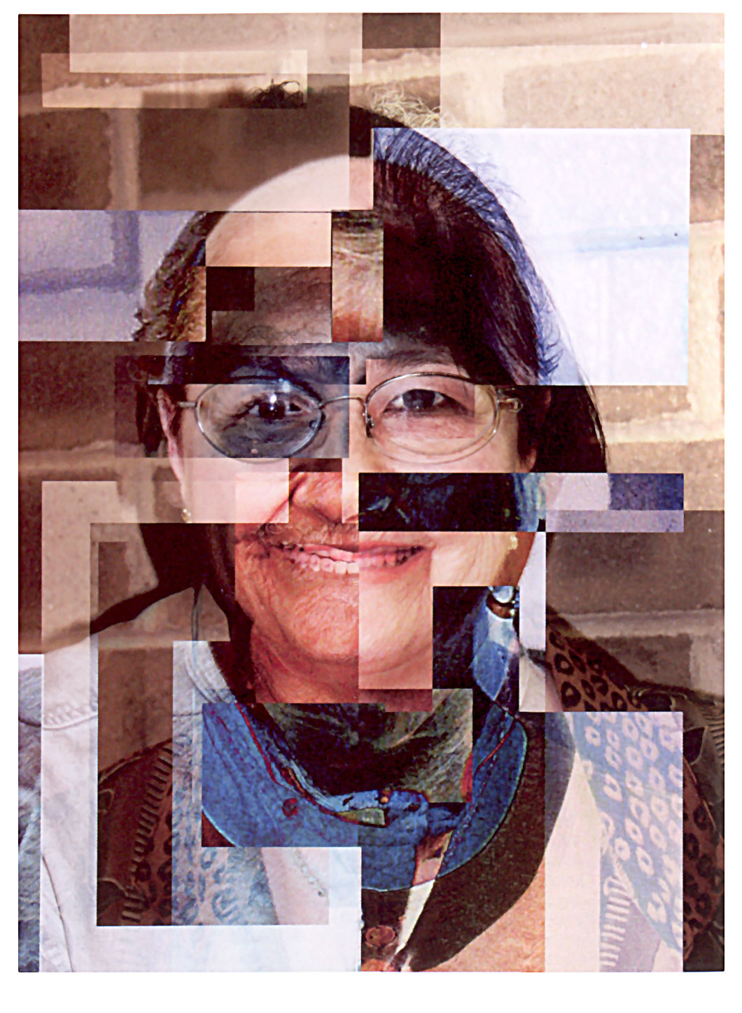
Defining Survivors and Survivorship
The Face of Cancer

Slide 16
NCI Survivor and Survivorship Definitions
Cancer Survivor: An individual is considered a cancer survivor from the time of diagnosis, through the balance of his or her life. There are many types of survivors, including those living with cancer and those free of cancer. This term is meant to capture a population of those with a history of cancer rather than to provide a label that may or may not resonate with individuals.
-Adapted from the National Coalition for Cancer Survivorship

Slide 17
Survivorship Defined
Living cancer free
  For remainder of life
  Experiences > 1 treatment complication
  But dying after a late recurrence
  But develops another cancer
Living with cancer
  Intermittent periods of active disease on/off treatment
  Continuously without disease free period

Slide 18
Survivorship Definition and Attributes
Defined as those who have lived through a potentially deadly or life altering event.
It is a dynamic process
It involves uncertainty
It is a life changing experience
It has duality of positive and negative aspects
It is an individual experience with universality
      Berry, LL., Davis, S., Flynn AG, et al. (2019). Is it time to reconsider the term ‘cancer survivor’. J Psychosocial Oncology; 37(4):413-426.
      Doyle, N. (2008) Cancer survivorship: evolutionary concept analysis. J Adv Nursing, 62(4): 499-509.
      Hebdon, M. (2015). Survivor in the cancer context: a concept analysis. J Adv Nursing, 71(8): 1774-1786.
      Marzorati, C., Riva, S., Pravettoni, G. (2017). Who is a cancer survivor? J Cancer Education; 32:228-237.
      Peck (2008) Survivorship: A concept analysis. Nsg. Forum, 43(2), 91-102.

Slide 19
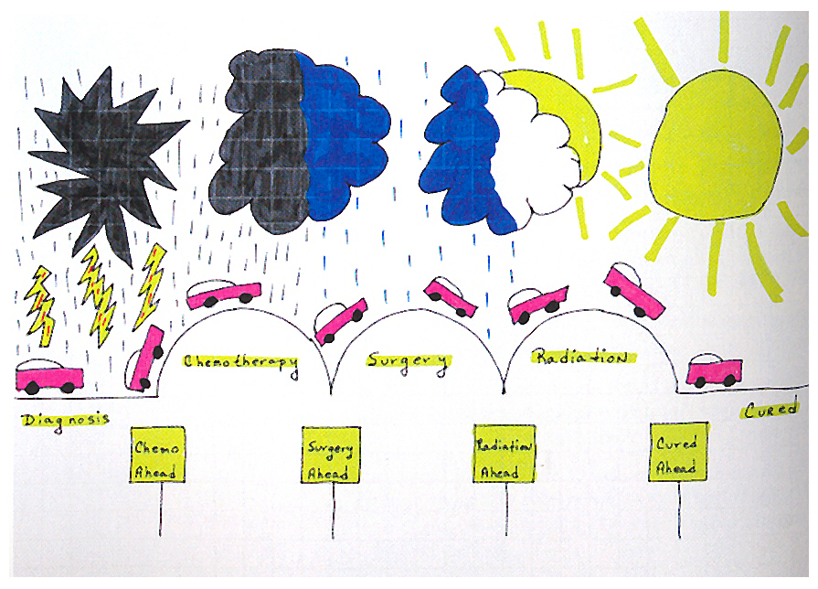
Bumps on the Road of Life

Slide 20
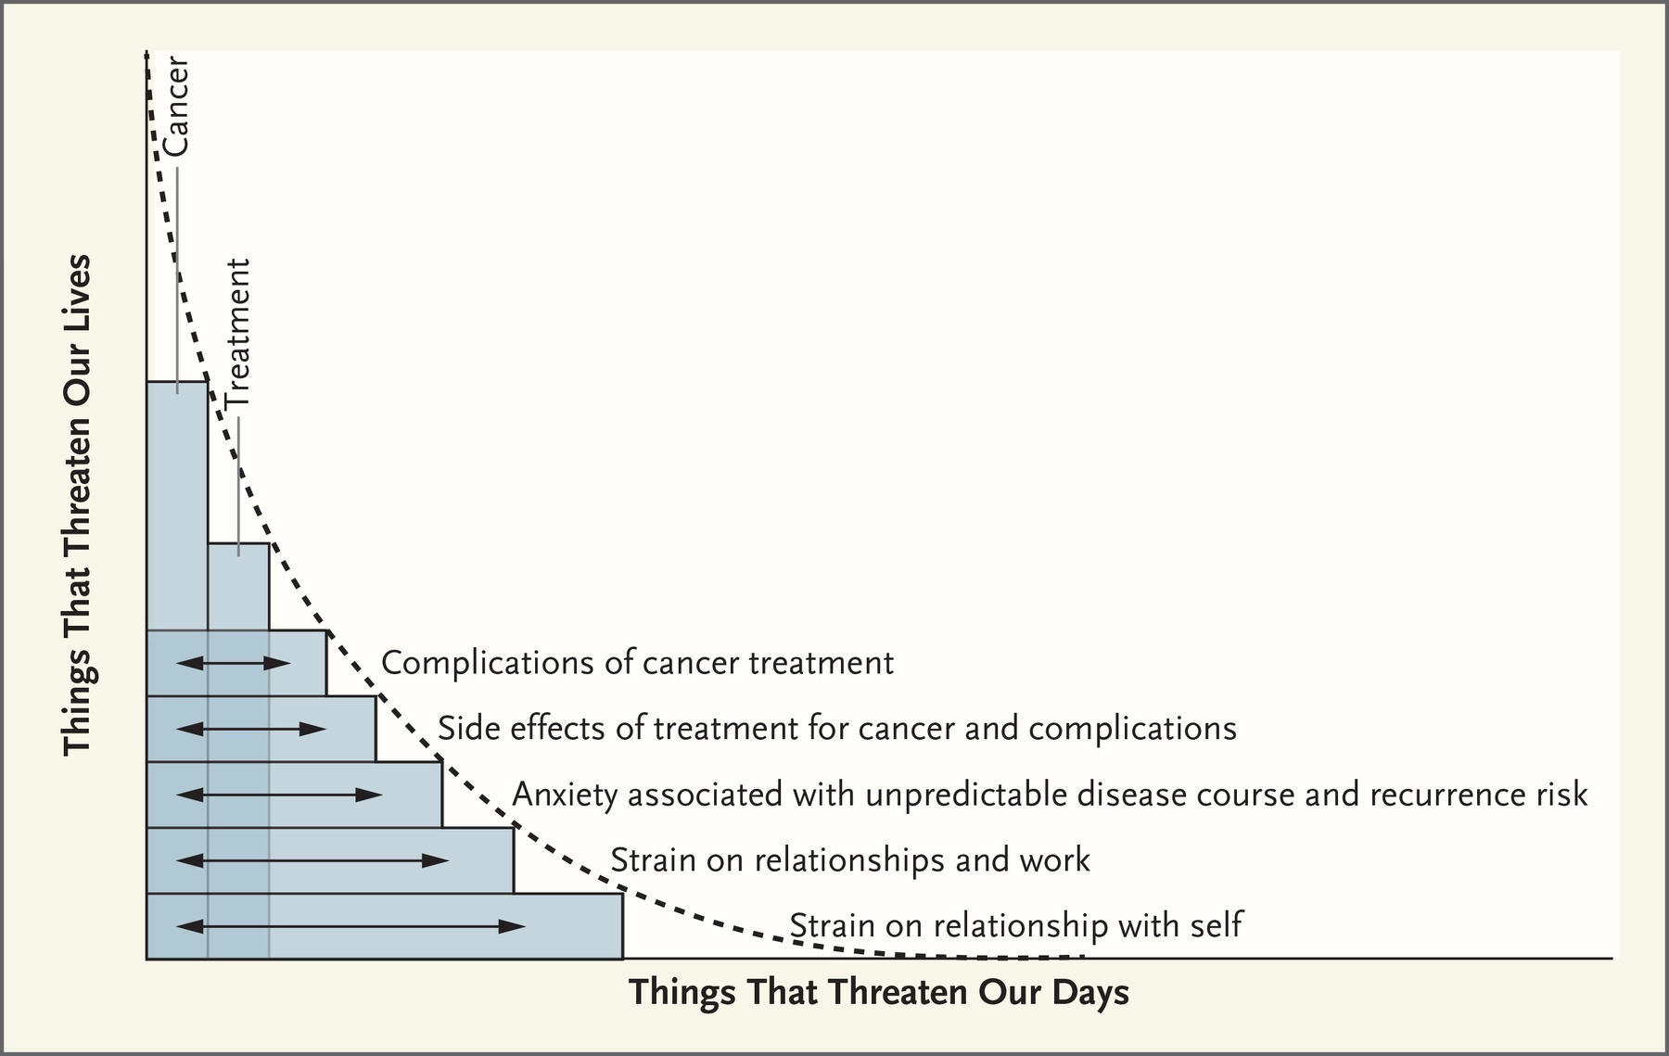
The Reality of Cancer (ROC) Curve
‘Life is the at the same time more vibrant and more dispiriting, more rich and more challenging, more wonderful and more exhausting, more assured yet more uncertain.’
Walker, S. Receiver Operator Curve Redefined-Optimizing Sensitivity (and Specificity) to the Lived Reality of Cancer. N Engl J Med 2019; 380:1594-1595
Notes:
A receiver operating characteristic curve, or ROC curve, is a graphical plot that illustrates the diagnostic ability of a binary classifier system as its discrimination threshold is varied. An ROC space is defined by FPR and TPR as x and y axes, respectively, which depicts relative trade-offs between true positive (benefits) and false positive (costs).
The ROC curve is created by plotting the true positive rate (TPR) against the false positive rate (FPR) at various threshold settings. The true-positive rate is also known as sensitivity, recall or probability of detection^{[4]} in machine learning. The false-positive rate is also known as the fall-out or probability of false alarm^{[4]} and can be calculated as (1 − specificity). It can also be thought of as a plot of the power as a function of the Type I Error of the decision rule (when the performance is calculated from just a sample of the population, it can be thought of as estimators of these quantities). The ROC curve is thus the sensitivity as a function of fall-out. In general, if the probability distributions for both detection and false alarm are known, the ROC curve can be generated by plotting the cumulative distribution function (area under the probability distribution from −∞ to the discrimination threshold) of the detection probability in the y-axis versus the cumulative distribution function of the false-alarm probability on the x-axis.
ROC analysis provides tools to select possibly optimal models and to discard suboptimal ones independently from (and prior to specifying) the cost context or the class distribution. ROC analysis is related in a direct and natural way to cost/benefit analysis of diagnostic decision making.
The ROC curve was first developed by electrical engineers and radar engineers during World War II for detecting enemy objects in battlefields and was soon introduced to psychology to account for perceptual detection of stimuli. ROC analysis since then has been used in medicine, radiology, biometrics, forecasting of natural hazards,^{[5]} meteorology,^{[6]} model performance assessment,^{[7]} and other areas for many decades and is increasingly used in machine learning and data mining research.
The ROC is also known as a relative operating characteristic curve, because it is a comparison of two operating characteristics (TPR and FPR) as the criterion changes.

Slide 21
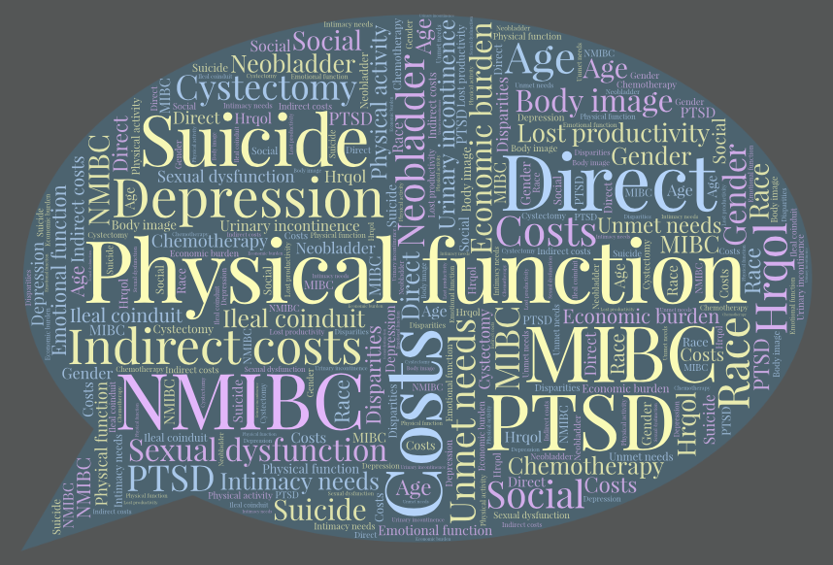
Bhanvadia. Curr Urol Rep. 2018;19(12):111.
Chung J. Support Care Cancer. 2019; Epub
Edmondson AJ. J Cancer Surviv. 2017;11(4):453-461.
Gopalakrishna A. Urol Oncol. 2017;35(9):540.e1-540.e6.
Jung A Cancer Nurs. 2019;42(3):E21-E33.
Leal J. Eur Urol. 2016;69(3):438-47.
Mak KS. Int J Radiat Oncol Biol Phys. 2016;96(5):1028-1036.
Mohamed NE. Urol Oncol. 2016; 34(12):531.e7-531.e14.
Mossanen M. Curr Opin Urol. 2014;24(5):487-91.
Paterson C. Eur J Oncol Nurs. 2018;35:92-101.
Sievert KD. World J Urol. 2009;27(3):295-300.
Smith AB. BJU Int. 2018;121(4):549-557.
Svatek RS. Eur Urol. 2014;66(2):253-62.
Taarnhøj GA. Health Qual Life Outcomes. 2019;17(1):20.
Tyson MD. Urol Clin North Am. 2018; 45(2):249-256.
Notes:
Women, younger than 60, non-whites have harder time

Slide 22
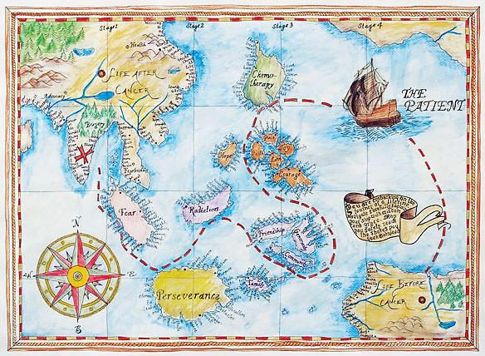
Uncharted
Models of Survivorship Care

Slide 23

Essential Components of Survivorship Care
    Prevention of recurrent and new cancers and other late effects
    Surveillance for cancer spread, recurrence or new cancers and assessment and mitigation of physical and psychosocial late effects
    Health Promotion
    Coordination between specialists and primary care providers to ensure that the survivors health needs are met
Notes:
Plus:
Implementing demonstration projects to test models of coordinated, multidisciplinary survivorship care
Supporting the development of comprehensive cancer control plans in each state
Educating health care providers to specifically address the health care and quality of life issues facing cancer survivors
Further research on cancer survivorship care issues

Slide 24
Adult Follow-up Care Models
Multidisciplinary
Disease specific
Consultative service
Integrated care model
Risk-stratified and shared care
Jacobs & Shulman (2017) Lancet Oncol; 18: e19-29.
Notes:
Multidisciplinary: several providers care on same day, resource intense, not disease specific
Disease specific: separate clinics for each disease
Consultative service: one visit
Integrated care model: extension of cancer continuum, usually NP/PA care delivery
Risk-stratified and shared care: low, moderate and high risk of developing long-term and late effects, coordination between oncologists and PCP, transition to primary care.

Slide 25
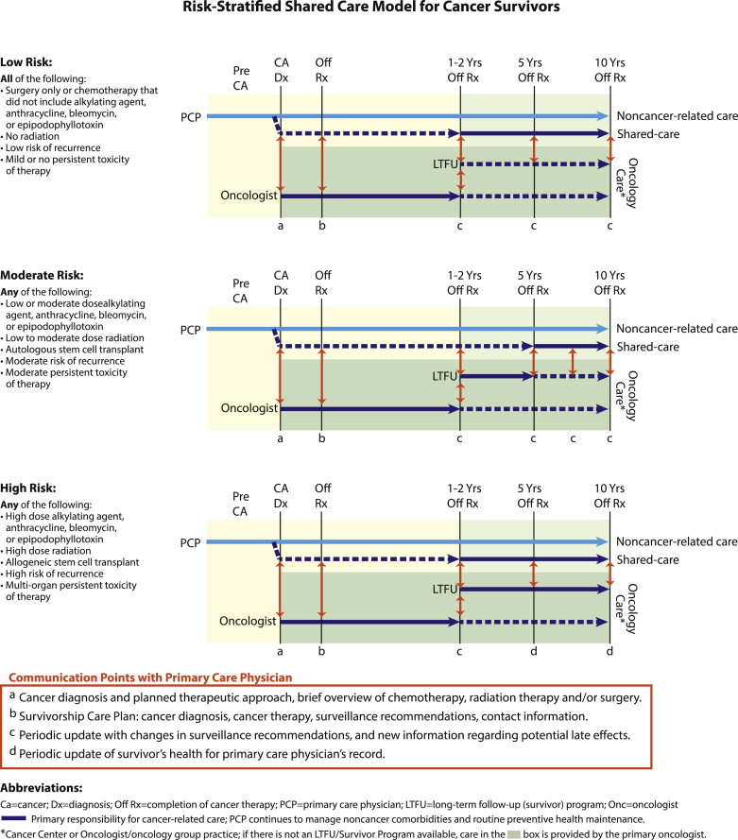
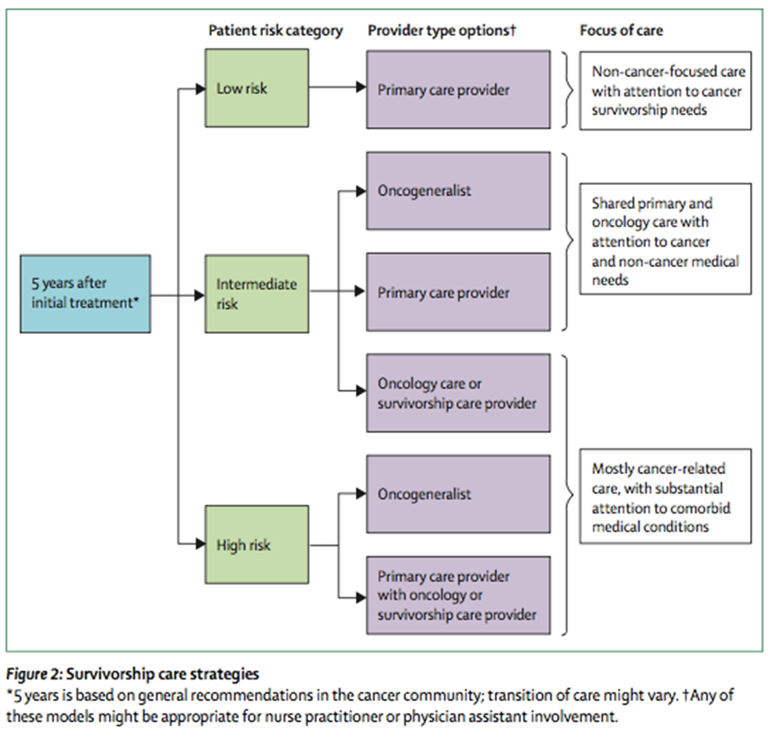
Nekhlyudov L, O’Malley D., Hudson SV. (2017). Lancet Oncology, 18: e30-e38
McCabe MS, et al. (2013) Semin Oncol., 40:804-12
Notes:
Triaged models of care have been suggested since 2006 but have not been systematically implemented. These models do not look at other than surveillance visits or needs.

Slide 26
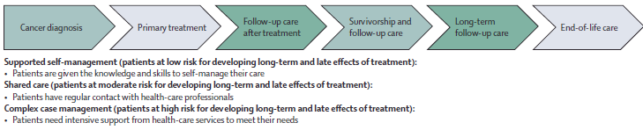
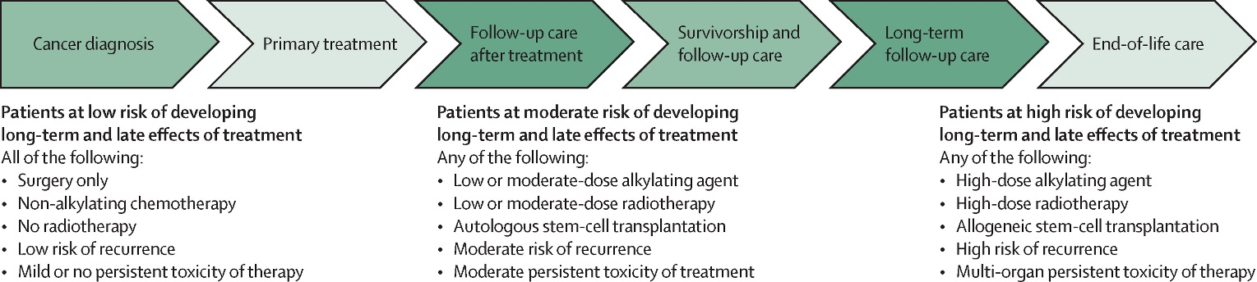
Risk Stratified Model National Cancer Survivorship Initiative
Risk Stratified Shared Care Model
Jacobs & Shulman (2017) Lancet Oncol; 18: e19-29.
Notes:
Risk-stratified and shared care model
In this model, cancer care is delivered at any timepoint along the continuum by different providers on the basis of risk category and patient and provider preferences and skillsets.
Risk-stratified model of the National Cancer Survivorship Initiative
This model is developed by the National Cancer Survivorship Initiative⁷⁹ in the UK using patient-reported outcome measures integrated into eHealth platforms to help risk stratify patients.

Slide 28
Lessons from Other Countries
England and Northern Ireland(National Cancer Survivorship Initiative or NCSI)
  Triage to one of three pathways based on risk of recurrence, subsequent cancers and late effects; severity of ongoing treatment sequalae; functional ability; psychosocial issues; health literacy and ability to self-manage:
    Supported self-management
    Shared care with self-management on provider (either PCP or Oncologist)
    Complex care management
  14 sites in England for CRC, breast and prostate cancers
    50% CRC, 80% Breast and 50% prostate patients treated with curative intent → supported self-management
    Projected savings of ￡90m/5 years with 58% breast patients supported self-management
    https://www.macmillan.org.uk/_images/sustainable-cancer-service-redesign_tcm9-298128.pdf

Slide 29
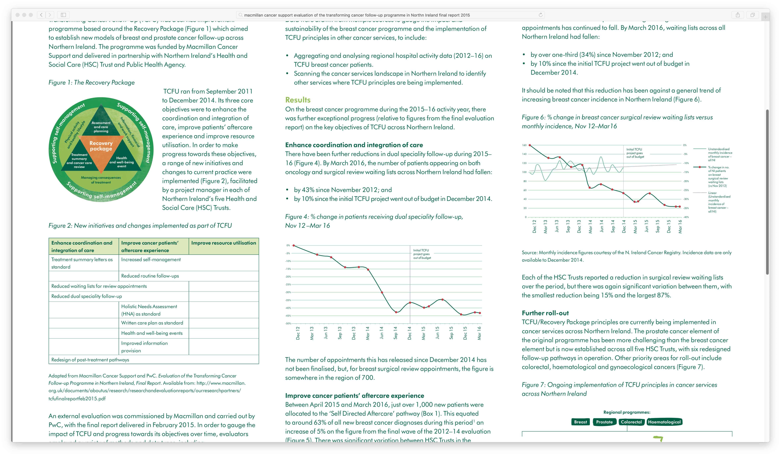
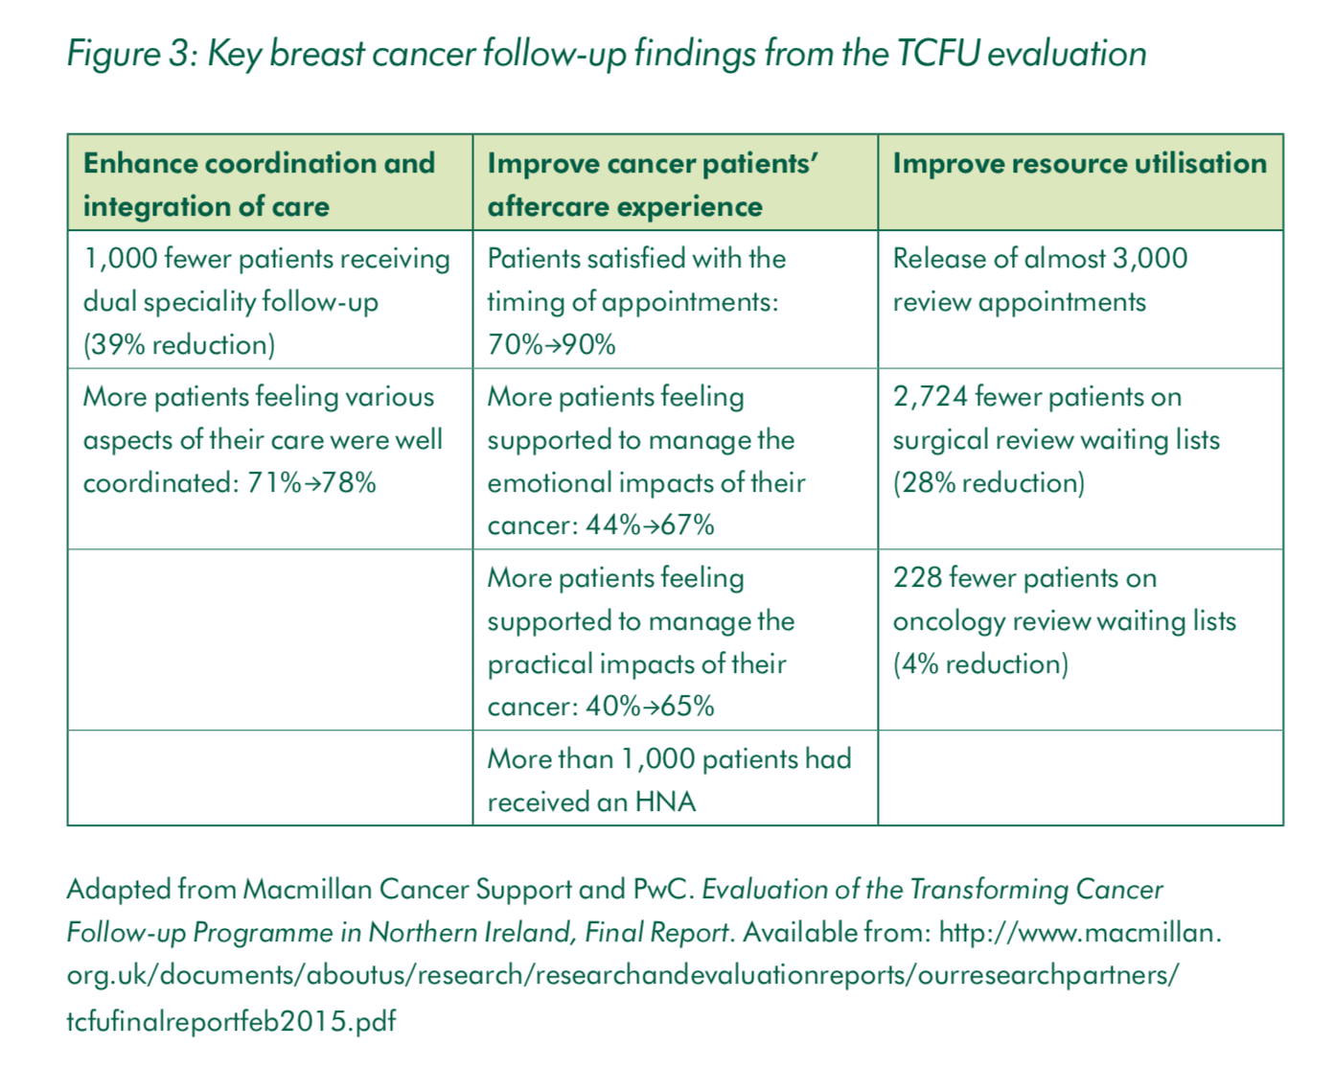
Sustainable Cancer Redesign
https://www.macmillan.org.uk/_images/sustainable-cancer-service-redesign_tcm9-298128.pdf
https://www.england.nhs.uk/improvement-hub/wp-content/uploads/sites/44/2017/11/Stratified-Pathways-of-Care.pdf
https://www.nice.org.uk/savingsandproductivityandlocalpracticeresource?id=2632

Slide 30

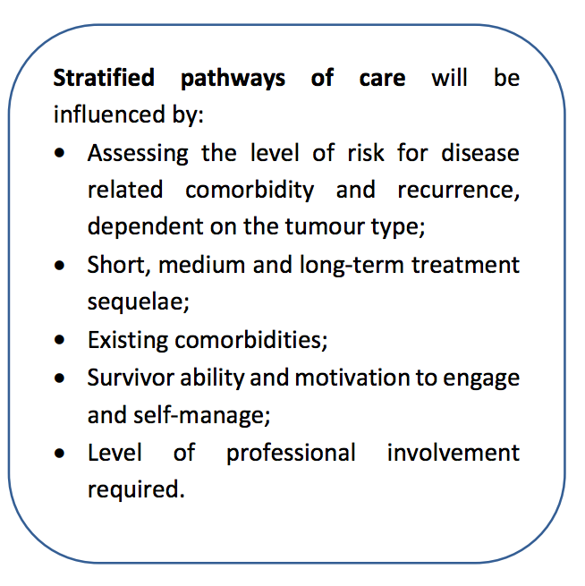
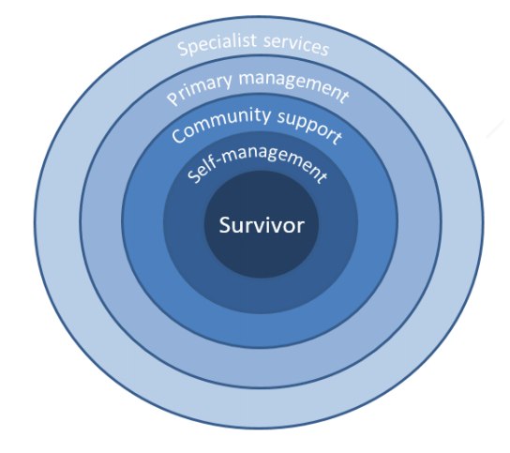
https://www.cosa.org.au

Slide 31
Principles of Personalized Follow-up Care Pathways
Triage into care pathways is influenced by more than risk of recurrence, subsequent cancers or late effects.
Patient-identified issues should guide the delivery of care.
Remote monitoring should be used to imbed a survivor in a surveillance system to monitor them for the exacerbation of ongoing cancer-related symptoms or functional limitations, and for early recurrence, new cancer, or late effects detection.
Shifting patients to supported self-management and reducing face-to-face clinic visits is critical for improving clinic utilization and cost outcomes.
Coordination and information exchange among oncology, primary care, specialists and patients is essential.
Engaging all stakeholders, securing their buy-in, and using change management and continuous improvement principles are critical for successful follow-up care transformation.

Slide 32
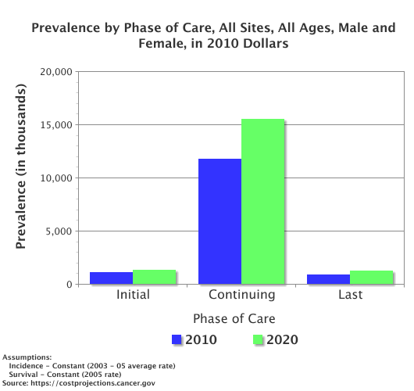
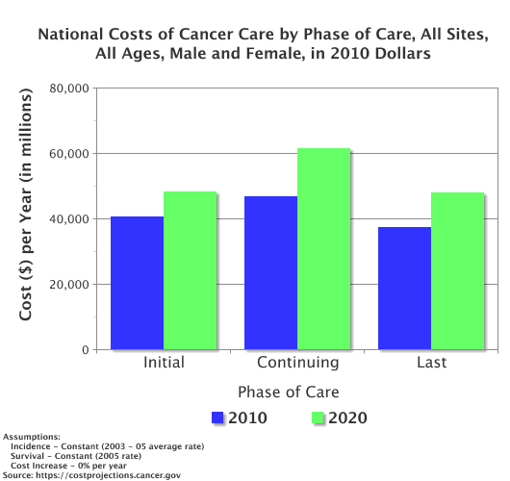
Continuing Care for Cancer Survivors
https://costprojections.cancer.gov/
Notes:
Cost
Initial Continuing Last
2010 $40,464 $46,643 $37,459
2020 $48,317 $61,373 $48,077
Increase 19.4% 31.6% 28.3%
Costs ($) per year in millions.
Prevalence
Initial Continuing Last
2010 1,079,991 11,790,829 900,965
2020 1,306,479 15,547,832 1,216,414
Increase 21.0% 31.9% 35.0%

Slide 33
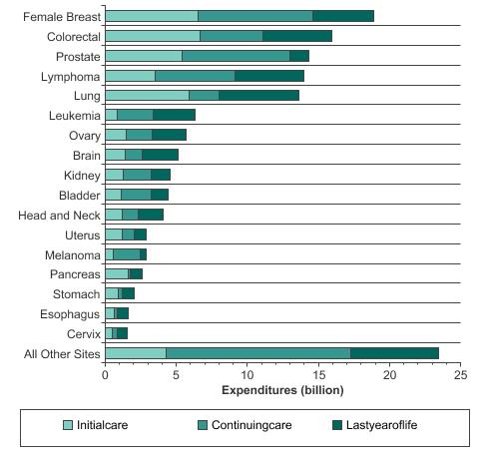
Estimates Of National Expenditures For Cancer Care, By Site

Slide 34

Cancer Survivors at Duke
January 1, 2016 – June 30, 2017 (18 months), the following unique patients were seen:
Interval from Cancer Diagnosis
0-2.9 y 3-4.9 y 5-9.9 y 10-20 y Total
Brain | 3143 | 826 | 1092 | 747 | 5808
Breast | 4175 | 1713 | 2487 | 1972 | 10347
Cell Therapy | 2826 | 1036 | 1523 | 976 | 6361
Endocrine | 1250 | 352 | 394 | 238 | 2234
Eye | 182 | 52 | 59 | 30 | 323
GI | 5041 | 1099 | 1250 | 526 | 7916
GU | 4495 | 1641 | 2635 | 1696 | 10467
Gyn | 2160 | 772 | 968 | 467 | 4367
H&N | 1023 | 304 | 430 | 229 | 1986
Melanoma | 1471 | 504 | 644 | 471 | 3090
Other sites | 252 | 29 | 42 | 24 | 347
Sarcoma | 563 | 201 | 269 | 152 | 1185
Thoracic | 4658 | 827 | 925 | 367 | 6777
Grand Total | 31239 | 9356 | 12718 | 7895 | 61208
Courtesy of Steve Power and Phillip Maxwell
Source: Kevin Oeffinger, MD, Duke 4.19

Slide 35
UNC Follow-up Visits
10 Years of Follow-up
Total Visits
 | Fiscal Year 2016 |  | Fiscal Year 2017 |  | Fiscal Year 2018
 | New | Return | New | Return | New | Return
Total New/Return | 13005 | 59820 | 13683 | 66800 | 14561 | 84260
Total Encounters | 72825 (82%) |  | 80483 (83%) |  | 84260 (83%)
5 years of follow-up
Assumptions:
5% new cases/year
50% of all new cases will be followed long term.
Follow-up begins year 2 with 4 visits, year 3=3 visits, year 4=2 visits, year 5-10=1 visit or 0 visits

Slide 36
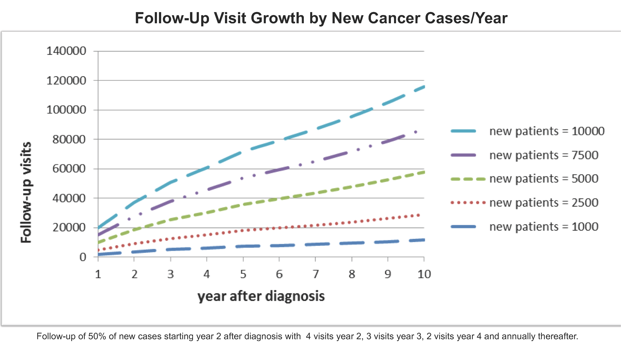

Slide 37
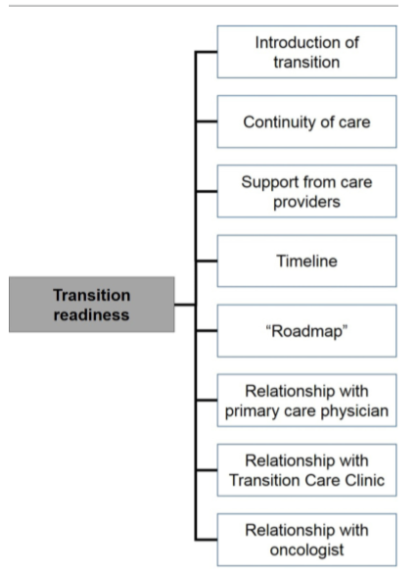
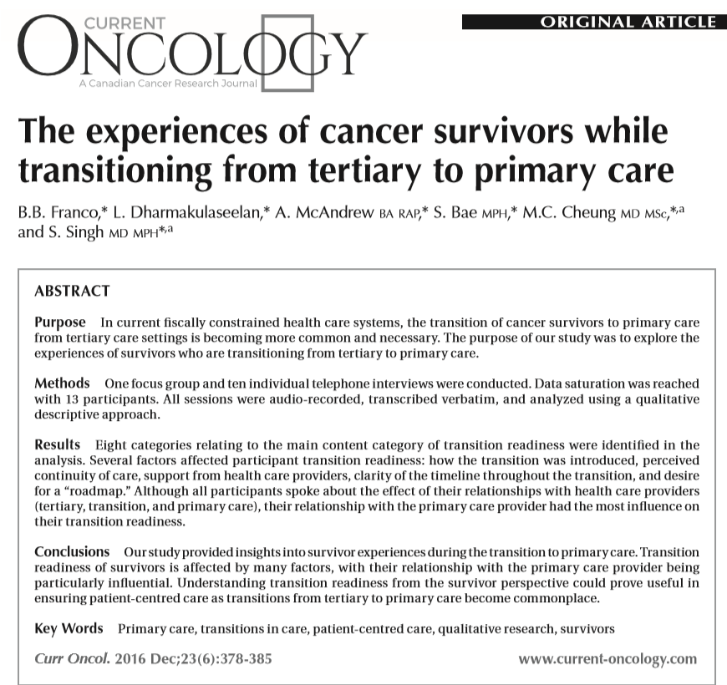

Slide 38
Actions Oncology Clinicians Can Pursue Now
Clearly communicate to patients from the time of diagnosis that they will be expected to continue to be followed by their primary care provider and likely will transition back to predominately primary care after treatments ends.
Examine current patient rosters, clinic utilization patterns, and new patient visit slots →consider how shifting care of low‐risk/low‐need survivors to primary care or advanced practice practitioners would affect these factors.
Alfano, C. et al. CA Cancer J Clin. 2019;69(3):234-247

Slide 39
Actions Oncology Clinicians Can Pursue Now
Reinforce expectations about follow‐up by ongoing communication throughout cancer treatment.
Shift follow-up appointments for patients off treatment so they are clustered.
Support patients who are doing well in self‐managing their health.
Build bridges with primary care.
Alfano, C. et al. CA Cancer J Clin. 2019;69(3):234-247

Slide 40
Challenge
Get your institution to provide the numbers of follow-up visits by time since diagnosis.
Identify PCP interested in taking care of survivors in your area.
Reorganize your follow-up of patients off treatment to their own follow-up clinics→ first integrate and then move fully to APP → transition to PCP over time.
Discuss long-term plans of care with new patients throughout their care.

Slide 41

Survivorship Research
Picking up my pieces

Slide 42
NCI Survivorship Research Definitions
Cancer Survivorship Research: Cancer survivorship research seeks to improve the health and well-being of cancer survivors and caregivers providing care to survivors.
It aims to improve understanding of the sequelae of cancer and its treatment and to identify methods to prevent and mitigate adverse outcomes, including functional, physical, psychosocial, and economic effects.
This research also includes and informs the design, delivery, and implementation of evidence-based strategies and the coordination of healthcare services to optimize survivors’ health and quality of life from the time of diagnosis through the remainder of the survivor’s life.
Any cancer survivorship research should clearly identify the type of survivor being studied (e.g. age, type and stage of cancer, time since diagnosis) and the outcomes of the research (e.g. function, quality of life, health care utilization, costs, survival).

Slide 43
Adapted from Nekhlyudov, L, Mollica, M., Jacobsen, P., Mayer, DK, Shulman, LN, Geiger, AM. (2019). Developing a Quality of Cancer Survivorship Care Framework: Implications for Clinical Care, Research and Policy. JNCI, epub ahead of print

Slide 44
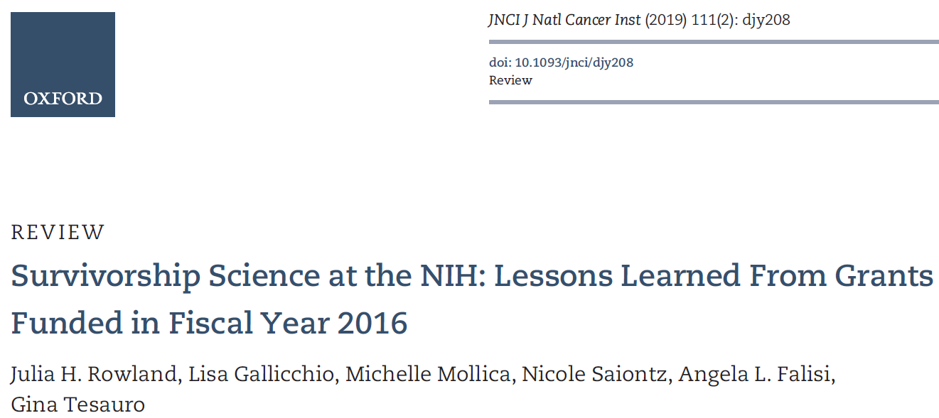
NIH Survivorship Research Portfolio Analysis (2016)
Review of 165 eligible grants:
88.5% were funded by the National Cancer Institute followed by NINR, NIH OD, and NIA
85.6% of NCI studies funded by DCCPS
66.7% were investigator-initiated (R01) mechanism
84.2% focused on adult survivors
47.3% focused on breast cancer survivors
64.2% focused on <2 years since diagnosis
57.3% were observational in nature (57.3%)
4.8% older adults and 3% rural populations
Topics included:
  75.8% physiologic outcomes
  37.6% psychosocial outcomes
  35.7% health behaviors
  35.7% patterns of care
  economic/employment outcomes

Slide 45
NIH Survivorship Research Portfolio Analysis (2016)
Research recommendations:
  Increase diversity of cancer sites
  Greater ethnoculturally diverse samples
  More older (>65 years) and longer-term (>5 years) survivors
  Need to address effects of newer therapies

Slide 46
NCI Future Directions in Cancer Survivorship Research: Workshop priorities and Webinar endorsements
Identify and present the research gaps in the recommended components of survivorship care and important next steps that were identified at a recent NCI meeting; and
Gather feedback on the identified strategic research priorities (SA-SD).

Slide 47
Survivorship Research Priorities
Prevention and Surveillance
(87% Agree)
Physical Late/Long-term
(91% Agree)
Surveillance schedules
  Testing optimal frequency, risks and benefits and bundled screening
  Evidence-based guidelines consistent across organizations
Reducing disparities among different populations
Adding longer surveillance for existing, relevant clinical trials
Enhancing SEER, State Registries and National Cancer Databases
Measurement of symptoms, functional impairments, comorbid conditions and needs as core measures by disease
Profiles of natural history of late/long-term effects in prevalent cancers
Frame intervention development using chronic disease model (CDM) as it is multilevel and is patient and family focused at its core and spans risk reduction, rehabilitation and self-management support

Slide 48
Survivorship Research Priorities
Psychosocial Late/Long-term
(89% Agree)
Health Behaviors
(87% Agree )
Implementation of psychosocial interventions in real-world settings (e.g. community oncology, primary care)→integration of psychosocial services into existing community systems.
Prevention and mitigation strategies that include risk-stratification
Mechanisms and biomarkers for health behaviors
Integration of exiting and emerging technologies for health promotion in cancer survivorship care
Multi-level research studies addressing health behaviors in cancer survivors

Slide 49
Survivorship Research Priorities
Care Coordination
86% Agree
Economic
90% Agree
Identify key outcomes to assess quality care coordination
What are optimal models to promote risk-based care coordination?
  What are key strategies to support vulnerable populations?
How to engage IT in care coordination
Longitudinal studies to understand risk factors for financial hardship, employment limitations and other economic effects.
Studies to understand the impact of financial hardship, employment limitations and other economic effects on functioning, clinical outcomes, quality of life and healthcare utilization.
Conduct new interventions to address economic effects and leveraging implementation science to ensure effective interventions are disseminated.
Leverage data infrastructure, linkages, and methods
Leverage technology to collect data and deliver interventions.

Slide 50
Conclusions
Current cancer cancer can not be sustained
More survivorship research to help prevent or mitigate long term and late effects
There is no one solution to address this issue but all require culture change in cancer care delivery.
Projections for staff and facilities must go beyond # new cases and beyond the next 1-2 years.
Shifting model for follow-up survivorship care is part of the solution but needs to be based on risk stratification, collaboration between PCP and Oncologists, team based care, and supported self-management.
Multiple strategies need to be tested.
We need to develop and implement a range of evidence-based programs that do not require 1:1 face-to-face interventions.

Slide 51
Additional References
Alfano CM, Leach CR, Smith TG, Miller KD, Alcaraz KI, Cannady RS, Wender RC, Brawley OW. (2019). Equitably improving outcomes for cancer survivors and supporting caregivers: A blueprint for care delivery, research, education, and policy. CA Cancer J Clin.;69(1):35-49.
Alfano, CM, Mayer, DK, Bhatia, S, Maher, J., Scott, JM, Nekhlyudov, Merrill, JK, Henderson, TO.(2019). Implementing personalized pathways for cancer follow-up care in the United States: Proceedings from an American Cancer Society-American Society of Clinical Oncology Summit. CA Cancer J Clin; 0:1-14.
Alfano, CM, Jefford, M, Maher, J, Birken, SA, Mayer, DK. (2019). Building Personalized Cancer Follow-up Care Pathways in the US: Lessons Learned from Implementation in England, Norther Ireland, and Australia. ASCO Education Book, in press.
Dentzer, S. (ed). (2018). Health Care Without Walls: A Roadmap for Reinventing US Health Care. Boston, MA: Network for Excellence in Health Innovation (NEHI)
Mayer, DK, Alfano, CM (2019). Personalized Risk-Stratified Cancer Follow-Up Care: Its Potential for Healthier Survivors, Happier Clinicians, and Lower Costs. J Natl Cancer Inst. 2019 Feb 6. [Epub ahead of print]

Slide 52

When Life Is Sewn Back Together,
It Has Changed

